Slide 1
Support vector machines SVM Dr. Farhan hassan khan
MACHINE LEARNING

Slide 2
How does it work?
A support vector machine (SVM) is a supervised machine learning model that uses classification algorithms for binary classification problems.
After giving an SVM model sets of labeled training data for each category, they’re able to categorize new data.
Let’s imagine we have two classes: red and blue, and our data has two features.
Features: x and y. We want a classifier that, given a pair of (x,y) coordinates, outputs if it’s either red or blue.
We plot our already labeled training data on a plane.

Slide 3
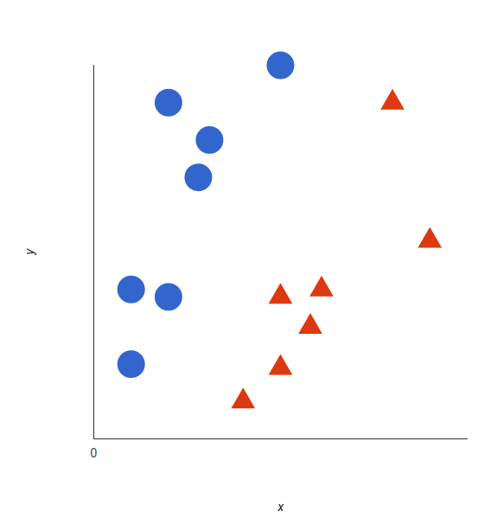
How does it work?

Slide 4
How it works?
A support vector machine takes these data points and outputs the hyperplane (which in two dimensions it’s simply a line) that best separates the tags. This line is the decision boundary.
Decision boundary: anything that falls to one side of it we will classify as blue, and anything that falls to the other as red.

Slide 5
Hyperplane
For SVM, it’s the one that maximizes the margins from both tags.
In other words: the hyperplane (remember it's a line in this case) whose distance to the nearest element of each tag is the largest.

Slide 6
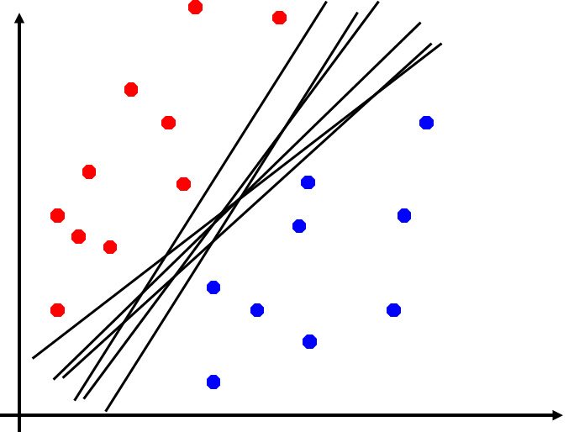
Hyperplane
Which of the linear separators is optimal?

Slide 7
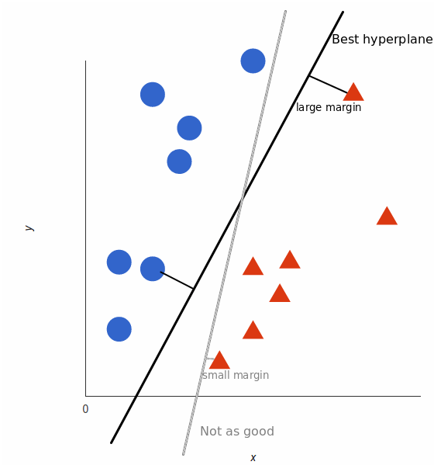
Hyperplane

Slide 8
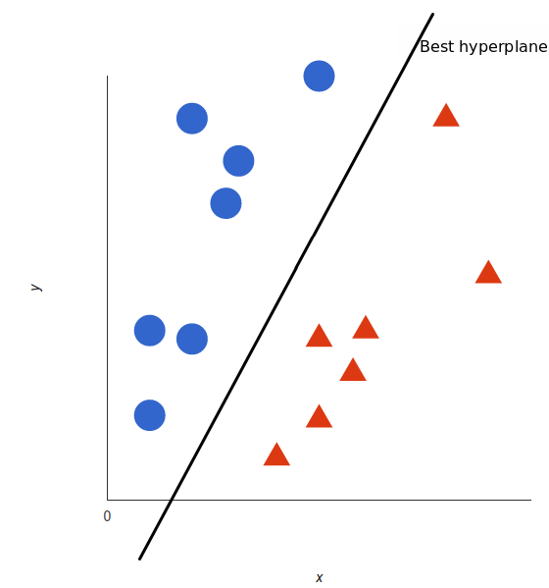
Hyperplane

Slide 9
Types of Support Vector Machine
Linear
Non-Linear

Slide 10
Types of Support Vector Machine
Linear SVM
When the data is perfectly linearly separable only then we can use Linear SVM.
Perfectly linearly separable means that the data points can be classified into 2 classes by using a single straight line(if 2D).

Slide 11
Types of Support Vector Machine
Non-Linear SVM:
When the data is not linearly separable then we can use Non-Linear SVM, which means when the data points cannot be separated into 2 classes by using a straight line (if 2D) then we use some advanced techniques like kernel tricks to classify them.
In most real-world applications we do not find linearly separable datapoints hence we use kernel trick to solve them.

Slide 12
Support VECTORS and margins
Support Vectors:
These are the points that are closest to the hyperplane.
A separating line will be defined with the help of these data points.
Margin:
It is the distance between the hyperplane and the observations closest to the hyperplane (support vectors).
In SVM large margin is considered a good margin

Slide 13

Support vector machine

Slide 14
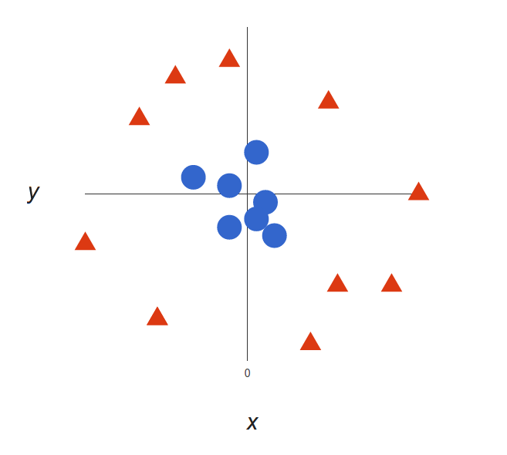
Non-linear Data

Slide 15
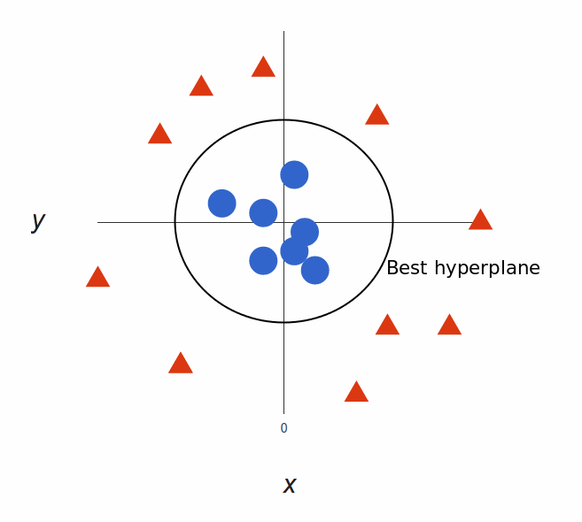
What can SVM do with this?

Slide 16
Decision Boundary
Our decision boundary is a circumference of radius 1, which separates both tags using SVM.

Slide 17
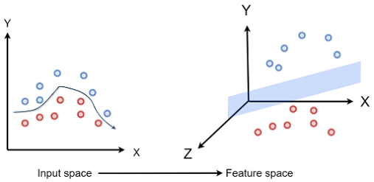
Kernel trick
Use a linear classifier to solve non-linear problem

Slide 18
Kernel Functions
Kernel Function is a method used to take data as input and transform into the required form of processing data.
“Kernel” is used due to set of mathematical functions used in Support Vector Machine provides the window to manipulate the data.
The kernel function is just a mathematical function that converts a low-dimensional input space into a higher-dimensional space.
This is done by mapping the data into a new feature space. In this space, the data will be linearly separable.
This means that a support vector machine can be used to find a hyperplane that separates the data.

Slide 19
Types Of Kernel Functions
Linear
Polynomial
Gaussian Kernel Radial Basis Function (RBF)
Sigmoid

Slide 20
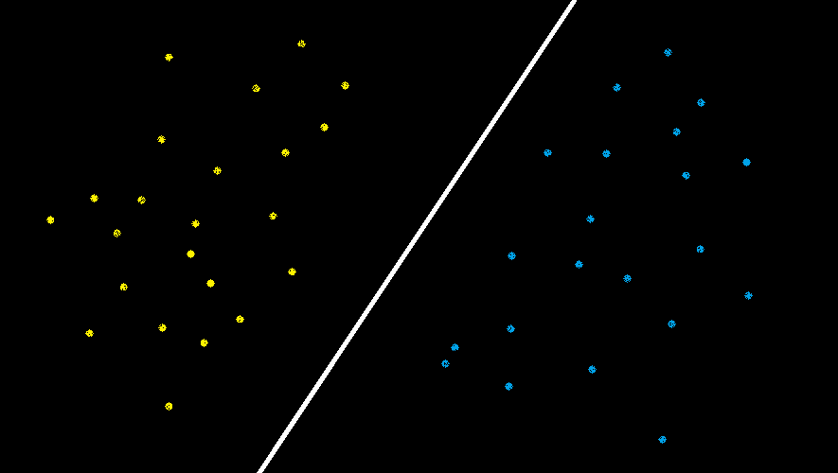
Linear kernel function
The linear kernel is the simplest and is used when the data is linearly separable
A linear kernel can be used as normal dot product any two given observations.
The equation for the kernel function is:
K(x, xi) = sum(x * xi)

Slide 21
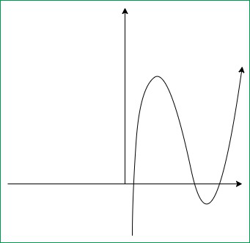
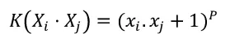
Polynomial KERNEL function
The polynomial kernel is effective for non-linear data.
It computes the similarity between two vectors in terms of the polynomial of the original variables.

Slide 22
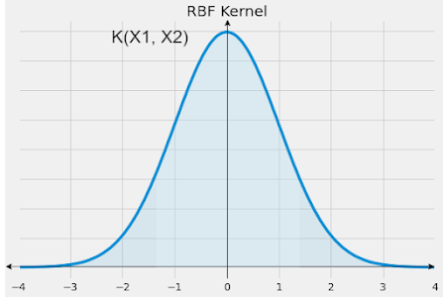

Gaussian Radial basis function (RBF) Kernel
As you can see that the Distribution graph of the RBF kernel actually looks like the Gaussian Distribution curve which is known as a bell-shaped curve.
Thus RBF kernel is also known as Gaussian Radial Basis Kernel.

Slide 23
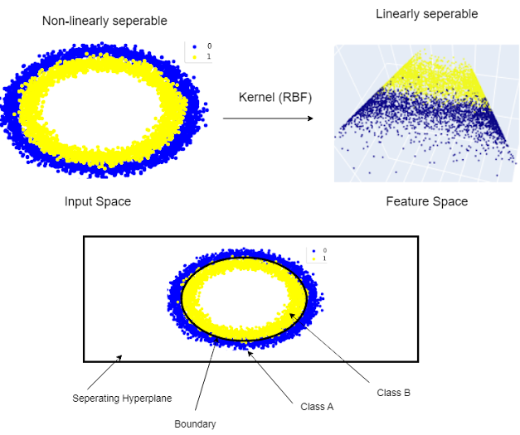

Slide 24
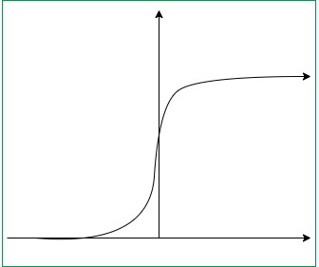
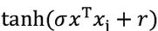
Sigmoid kernel function
An SVM with a sigmoid kernel is equivalent to a simple two-layer neural network known as a multilayer perceptron (with no hidden layers).
Suitable for neural networks
Not widely used in SVM.

Slide 25
Choosing a Kernel Function
Choosing a kernel totally depends on what kind of dataset are you working on.
If it is linearly separable then you must opt. for linear kernel function since it is very easy to use and the complexity is much lower compared to other kernel functions.
Usually, we use SVM with RBF and linear kernel function because other kernels like polynomial kernel are rarely used due to poor efficiency.

Slide 26
SVM Advantages
SVM works better when the data is Linear
It is more effective in high dimensions
With the help of the kernel trick, we can solve any complex problem
SVM is not sensitive to outliers
Can help us with Image classification
SVM training always finds a global solution, unlike neural networks such as backpropagation, where many local minima usually exist

Slide 27
Disadvantages
Choosing a good kernel is not easy
It doesn’t show good results on a big dataset (millions of support vectors)
A major research goal regarding SVMs is to improve the speed in training and testing so that SVMs may become a more feasible option for very large data sets

Slide 28
SVM for multi-class classification
We have described linear and nonlinear SVMs for binary (i.e., two-class) classification.
SVM classifiers can be combined for the multiclass case.
A simple and effective approach,
Given m classes, trains m classifiers, one for each class
Classifier j learns to return a positive value for class j and a negative value for the rest.
A test tuple is assigned the class corresponding to the largest positive distance.

Slide 29
End of lecture

